Slide 1
MMA 801 Introduction to Management
Session 1 a) Course Overview
b) Strategic Decision-Making
c) Cineplex Case

Slide 3
MMA 801 Session 1 Outline
1. Lecture/discussion
a) Framing the course | 30 minutes
b) Strategy concepts | 30 minutes
2. Exercise #1: What is strategy?
a) Breakout room activity | 90 minutes
b) Presentations | 30 minutes
3. Debrief | 25 minutes
4. Preparation for session 2 | 5 minutes

Slide 4
MMA 801 Overview
High-Level Overview
Rust remover…welcome back to academia…low risk immersion "boot camp" focused on reviewing core business decision-making fundamentals.
Team dynamics…begin building your high-performance team in a low-risk, no-risk environment.
Build your storyline delivery skills…framing what to say and how to say it…within the context of presenting business findings.
Business analytics/AI framework…placing the program in the context of business and responding to business challenges.

Slide 5
MMA 801 Overview
Class Culture and Dynamics
Very diverse group in terms of management training and experience
Please share your experience with us
Huge volume of information squeezed into a small window
Keep it "fun" and "light"– let the statistics course be the challenge
Slides can serve as a bit of post-operative guide, as much as they can support the in-class session.

Slide 6
MMA 801 Delivery Schedule
Date | Topic | Case
May 7 | Managerial and Strategic Decision-Making | Cineplex
May 8 | Business Model Assessment & Reinvention | Roku
May 9 | Finance Fundamentals | Spotify
May 10 | Marketing Fundamentals | Hello Fresh
May 11 | Assignment Review and Assignment #1 Workshop

Slide 7
MMA 801 Deliverables
Assignment #1: Team-Based Case (35%)
Team-based presentation with slide deck
Submit electronically c/o course dropbox on D2L
Formal discussion of the assignment on May 11
Guidance document is posted to the course page on D2L
Team Presentations at the Toronto classroom on May 25 & 26

Slide 8
MMA 801 Deliverables
Assignment #2: Individual Analytics Reflection (65%)
Individual assignment
Content and written communication assessment
Guidance document is posted to the course page on D2L
Submit electronically c/o D2L dropbox
Submission due date – June 7, 2024 @ 11:59 pm
Discussion regarding this assignment to occur on May 7

Slide 9
Framing the Course and Program Linking Analytics & AI to Strategy and Management Decision-Making

Slide 10
Analytics, AI and Strategy
Strategic Objectives
Analytics Methodologies
In-House Solution
External Solution
AI Methodologies
In-House Solution
External Solution
Exists…Implement
Build
Contract
Purchase
Train
Implement

Slide 11
Reflection How Does Your Organization Manage Data?
Is data embedded within your organization's core decision-making process at both the strategic and tactical level?
Can data be processed, delivered, and acted on in real time?
Is data stored in an agile/flexible way for integrated use across the organization?
Is data treated like a product…designed to deliver value?
Is data management structured to ensure privacy, security, and resiliency?

Slide 12
MMA 801 Data, Value and Competencies
To use data to add value, we need to know the depth of our competencies
Do we know what data we have?
Do we know where this data is?
Do we have the tools to access it?
Do we understand the value equation we are trying to solve?
Can value be realized via measured insights from the data we possess (fit)?
Do we have the appropriate safeguards?

Slide 13
MMA 801 – Session 1
Analytics World
Performance Dashboards
Front-end Quoting Tools
Lead Prioritization
Churn Analytics
Dynamic & Rules-based Pricing
Transactional Data
Sourcing Data
Headcount Assessment
Data Ingestion
Data Cleansing, Optimization
Data Engineering
Scalable, Repeatable Process ID
True Data Ingestion Into The Decision-Making Process
Management World
Market Share & Revenue Increases
Trend Analysis
Customer Segmentation Analysis
Product innovation
Faster Time to Market
Customer Acquisition/Retention
Risk Mitigation
Operating Margins Improvement
Supply Chain Optimization
Improving the Customer Experience
Talent Optimization

Slide 14
MMA 801 Data & Strategic Decision-Making
CB = (NC + EC) - DC
Cineplex, Roku, Spotify, HelloFresh
Key Understanding Associated With This Formula
Customer Base Growth numerically is driven by Demand Creation, followed by Revenue Conversion
Revenue Growth is driven by activities relating to FOP (Frequency of Purchase) and ART (Average Revenue Per Transaction…i.e. basket size)
Margin Growth is driven by optimal price point leveraging and expense management…efficiency, and good cost vs. bad cost analysis
Underlying Strength of Analytics Ingestion
CB = Customer Base
NC = New Customers
EC = Existing Customers
DC = Deserting or Inactive Customers

Slide 15
MMA 801 Data and Strategic Management
Data Flow
Company Purpose
Deliver Dynamic Value to the marketplace in a way which is superior to rivals and drives performance
Machine Learning
AI Methodologies
Orbital Insights & Tracking
Crowd AI
Statistical Modeling
Transaction Data
Search Data
Social Media
Foot Traffic
Focus Groups
Surveys
Sensors
Digital Apps
Satellite imagery
Web Traffic
1000s of Data Points
Data
Pool
Descriptive
Predictive Prescriptive
Your primary role…develop data use into scalable insights or activities which can be used to increase business value.
Strategic Insights
Specific enough to enable us to design & redesign our business model
Do we know what data we have?
Do we know where this data is?
Do we have the tools to access it?
Do we have the appropriate safeguards?
Accelerated Solutions
Do we understand the value equation we are trying to solve?
Can value be realized via measured insights from the data we possess (fit)?
Core Data Fundamentals
Create Scalable insights for strategic decision-making
Identify distinctions
Quantify actions & activity redesign
Tailor messages
Data Scouts
Data Review & Purchase Experts
Data Architects and Engineers
Data Analysts
Scalable Insights

Slide 16
MMA 801 Analytics and Two Growth Paths
Salience - what do customers want… importance
Pricing
Access
Analytics …core to understanding where and how to attack your customer base and leverage new business opportunities
Revenue Growth Model
Acquire and grow your "New Customer" reach
Growth Levers
Experience…
what matters… enrich lives
Product
Two Growth Paths
Retain and enrich the value (win/win) of your "Existing Customer" base
Adapted From: forrester.com/blogs/introducing-forresters-revenue-growth-framework

Slide 17
MMA 801 Analytics and Profit Model
If we reduce price by 5% to enhance volume, will we improve profit?
Price Strategies
Data, Judgement, Methodology & Action
Can we reduce the costs of inputs (prediction)?
Have we fully identified and articulated the "ripple" effect of input reduction value?
Can we define and increase the predicted value of outputs?
Impact - beyond operational efficiency and into business model transformation?
Margin
Cost Strategies
Net Income
Market Share
Strategies
Can we increase EBITDA by x%
Volume
Market Size
Strategies
The critical component here is prediction accuracy…do you know what to predict?

Slide 18
Analytics, AI and Value Creation Outcomes
4 Key Areas of Analytics & AI Emphasis to Value-Creation Outcomes
Customer Value and Product Design
Portfolio Leveraging
Competitive Benchmarking
Internal Efficiencies & Partner (Forward & Backward) Chain Management
Understanding customer needs and benefit/cost trade-offs
Heat Mapping – growth and margin optimization
Avoid over-specification and excessive engineering
Cost management optimization
Source: Adapted from McKinsey…Analytics to Value, April 2021

Slide 19
AI Interest and Adoption: Some Key Questions
Can we drive relatively low-complexity productivity benefits with minimal investment?
Can we free up talent for higher-value activities?
Can we accelerate new product/service discovery?
Can we enhance the organization's capabilities to capture insights which might have otherwise been overlooked?
Can we create and leverage more effective personalized marketing campaigns, thereby driving stronger frequency of purchase or higher transaction value?

Slide 20
Business Case Challenge
Analytics & AI GVM Analysis
Absorption Challenge
Quality Improvement Challenge
Investment Challenge
Occupation Susceptibility
Occupational Spread
Cultural Absorption Rate
Innovation
Effect - TFP
Quantification
Effect - TFP
Near-Term
Mid-Term
Long-Term
Near-Term
Mid-Term
Long-Term
Software, Hardware, Services
Ecosystem Absorption Rate
Impact on Information Infrastructure
Impact on Communications Structure
Impact on Organizational Structure & Leadership
GVM = Growth Value Model
TFP = Total Factor Productivity

Slide 21
MMA 801 – Session 1
Critical Elements For Decision-making
Investment Depth (cost of the input to drive value)
Timing of the Investment Depth (staging, phasing, functionality itinerary)
Anticipated Value (quantified)
Timing of Value Return (sensitivity analysis)
Payback Period
Cost/Benefits
Investment Benefit Curve
Estimated Payback
Investment Cost Curve
Investment Burn
Time

Slide 22
Managerial Decision-Making – Strategic Planning
MMA 801 – Introduction to Management

Slide 23
Strategy and Areas of Responsibility
C-Suite & GM: 4 Areas of Responsibility
The development and communication of the organization's purpose, vision and overall strategic intent.
The management of the underlying business model core to successful strategy execution.
The timing, allocation, and procurement of the resources essential to the execution of the business-level and operating-level plans critical to success.
Creating and enabling a culture of continuous innovation, thereby ensuring the long-term health of the organization (active and marketing inertia avoidance).
Short-term Profitability
Long-term Position and Growth
Responsible Asset Development and Social Awareness…Environment, Society, Governance (ESG)

Slide 24
Goals and Strategies
4 Focal Points of the Strategy Reshaping Process
High-Confidence Growth Acceleration | Digital and GTM disruption identification, revenue acceleration via digitization, portfolio scaling, M&As, etc….defining and executing on Microburst opportunities.
Margin Improvement | Thinking digital across the value chain, defining "full-potential" benchmarks to aspire towards, reimaging the business model around key control points.
Productivity Transformation | Data and analytics focused on increased automation methodologies, omni-channel development, enhanced use of data, improved CRM systems.
Organization Structure Redesign | Rethink the ways of working, reimagine how we are structured, rethink the shape of our "talent" pool.
The Analytics "FIT" = data-driven management, fact-based dynamic pricing, analytics-based sales growth, customer-facing digitization, AI methodology implementation, CRM transformation, etc.

Slide 25
Triangle of Constraints
Time
- Speed of Execution
- Window of Opportunity
- Risk and Rate of Market Drift
Resource
Competencies
Capital, Capacity, Capabilities
Legacy Deployment & ROIC
Technology
Talent
Leadership
Market Position Competencies
Gap Analysis, Dissonance Recognition
Structural lock-in
Degree of Pivot/Shift Required

Slide 26
Putting it all together – The strategic planning process

Slide 27
Vision & Mission
Who we are
Corporate Level Strategy
What we want/need to do
Business Level Strategy
How we plan to win…magnitude of required pivot
Functional Level Strategies
Operating Plan
What we want to become
Where we want to do it
Governance
Vision – defines the fundamental direction, and sets the core parameters of decision-making guidance
Define
Our Purpose
Plan
Cross-functional execution decisions on how to win
Cascading Impact of Vision, Purpose and Mission
Execute
How resources will be allocated
To properly develop and/or assess a vision requires a full understanding of the concept of "Dynamic Intuitiveness"

Slide 28
6 Elements
What, in your opinion, frames a good strategic discussion (6 elements)?
Market Mapping (Shaping)
Best of Breed & Disruptive Rival Analysis
Competitive Position – Advantage, Parity, Disadvantage
Market Profitability & Attractiveness Analysis
Business Model Assessment
Vision and Purpose Clarity
Given this, what is the core outcome of strategic discussions?
The creation of dynamic intuitiveness (critical insights), which…
Define the purpose of what, where, how, by how much, and when we need to PIVOT (change, adjust, etc.).

Slide 29
Dynamic Intuitiveness
…allows you to respond to the following questions…
Do we have a clear understanding of market structure and the competitive landscape?
Is our belief as to what drives "customer value" still relevant?
What about drivers of profitability…have they changed?
Do we possess advantage relative to rivals? If so, where and for how long?
Do we have the right assets and capabilities to compete?
Do we need to adjust, reframe, reinvent our product/service strategy in order to succeed in maintaining or obtaining superior relative position (to rivals)?
Where and how are digital technologies and/or other factors reshaping the way that we do business?
What, and where are the new risks which we must respond to and overcome? How and when do we need to respond?

Slide 30
Strategy Decision-Making Circle
Strategy Decision-Making Circle
Recognize the forces & factors impacting your Ecosystem…Porter, PESTEL, Market Structure, SWOT, etc.
Dynamic Intuitiveness Assessment & Conclusions
Reset
Frame
(Dynamic Intuitiveness Conclusions)
Baseline
3 C Assessment
Search
(Option/Response
Identification)
Choose
(Craft Strategic Response & Plan)
Commit
(Resource procurement, allocation, sequencing)
Assess & Adjust
Track (KPMs), evaluate, adjust
Draw conclusions relating to competitive strength, relevancy & degree of change required
Data, Data, Data
Data, Data, Data
Strategic Vision
Execute the strategy & tactics (organic and inorganic)
Create & destroy response and opportunity options – multiple horizons
Create/redefine the "Value" delivery blueprint – add, maintain, enhance, reduce, remove.
Magnitude & speed conclusions
Business Model Reinvention

Slide 31
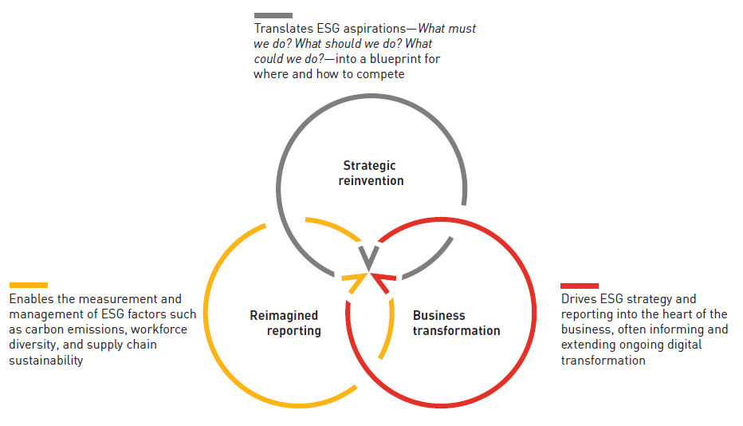
ESG & Strategy
“Whatever the starting point for the ESG dialogue, the project will result in changes in all dimensions of a business, including strategic decision-making, implementation of the new direction, and reporting of progress and outcomes…Not only are those dimensions interdependent, but each of them can create momentum that helps fuel the others.”
Adapted from Peter Gassmann, Casey Herman and Colm Kelly, Are you ready for the ESG revolution?, strategy+business (PwC), June 14, 2021 available at https://www.pwc.com/gx/en/issues/esg/esg-revolution.html.

Slide 32
MMA 801 5 Stages of DEI Maturity
Aware …successful older organizations that have never prioritized DEI or start-ups so deeply focused on survival that they’ve neglected to create strong human- capital practices.
Compliant …thinking is typically, “We do DEI because we have to.”
Tactical …have moved beyond meeting the rules imposed on them and are fully engaged in executing their own DEI initiatives, which tend to be bottom-up.
Integrated …aligned internal and external efforts and connected top-down and bottom-up efforts, and can truly say, “DEI is part of everything we do.”
Sustainable …DEI efforts pass stress tests such as economic challenges and changes in leadership, and their leaders have a mindset of continuous improvement.
Adapted from Washington, D. (2022). The five stages of DEI maturity.

Slide 33
Dynamic Intuitiveness – 4 Key Conclusions
Drivers of Profitability
Predicated on:
Understanding industry structure
Industry average price and cost fundamentals
Value curve fundamentals… linking to what customers are willing to pay for
Superior Relative Position
Predicated on:
Understanding the key activities which drive value, price and cost
Outperforming rivals within these key activities
Demand and Supply Relationship Shifts
Predicated on:
Understanding modest vs. disruptive change agents
Business model/system restructuring impact
Co-Competition
Shifts
Predicated on:
Understanding the relationship between the internal ecosystem, external networks and ecosystem
Strategic opportunity and dependency

Slide 34
Analytics, AI & Strategy
4 Ways Analytics and AI Can Support Strategic Planning
Assist in identifying early-stage trends…news alerts, rival activities, patent filings, investment data, etc.
Identification of new growth opportunities…market granulation to reveal segment clusters, sub-segment clusters (niches, potential acquisition targets, new applications for existing products and services).
Historical data mining associated with similar strategic moves…fact-based and stress test challenge (i.e. acquisition success and challenges…you want to grow by $100 million per year, but only 35% of companies who tried this achieved it…why were they successful, what rigorous execution is required)?
Anticipate complex market dynamics…agent-based modeling focused on understanding and predicting customer, competitor and regulator behaviour, potential impact on demand, supply, price elasticity, and other such insights.

Slide 35
MMA 801 So…What is Strategy?
A point of view, developed into a plan of action, with 4 key components
Where, Why, How to Compete and Win
Understands market direction, shaping, collision, and conflict
Tradeoff Acknowledgement
What not to do
Business Model Assessment
Critical activity identification
Competitive Advantage (SCA) Recognition
VRIN/VRIO…what we do is valuable, rare, inimitable, and non-substitutable
Agility vs. resiliency
Shift in asset heaviness and lock-in
Positioning – relative to rivals and customers
Sustained value recognition
Customer and rival behaviour prediction
Understands advantage, leverage, and sustainability of the SCA
Recognizes what to do, where to do it, and how to do it
Knows how to execute on it
Adaptability…allows flexibility to shift as dynamics continue to emerge

Slide 36
Multiple Horizons
Strategy is not short-term…it is about thinking and decision-making relating to multiple horizons.
Protect, Maintain, Enhance, Restore
Mid-Long-Term Growth and Profitability
What is NEXT...
opportunities needed to be pursued to ensure long-term growth and sustainability
Short-Term Profitability
What NEW adjustments need to be made to maintain portfolio momentum and develop new market share growth
H3
What needs to be done NOW…core product/service portfolio
H2
H1
McKinsey 3 Horizon Model

Slide 37
Driving Competitive Advantage
A true "Competitive Advantage" enables you to…Acquire, Engage, Delight, Retain
Price
Data and Technology Leveraging
Programming Content Quality & Depth
Platform Simplicity – Ease and Flexibility of Use
Driving WTP, Customer Satisfaction, Loyalty, and Retention

Slide 38
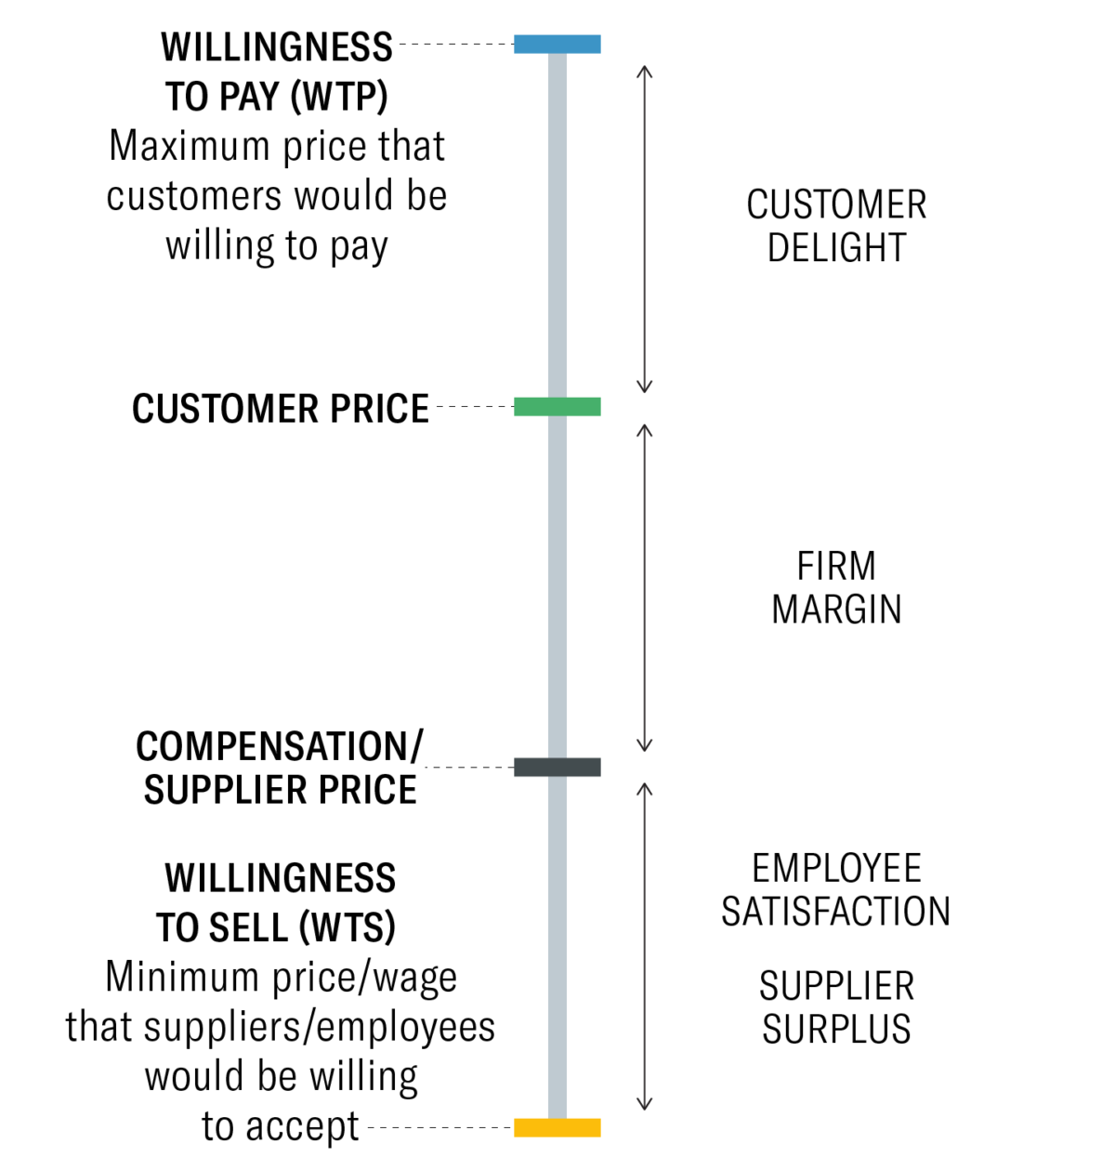
Strategy and Value
Strategy & Value
A Value Proposition Template
For ____________ (target customer)
who ____________ (statement of the need or opportunity), our (product/service name) is ____________ (product category)
that (statement of benefit) ____________ .
Adapted from Geoffrey Moore’s Crossing The Chasm: Marketing and Selling Disruptive Products to Mainstream Customers (Harper Collins, 2002).
Graphic from https://hbr.org/2021/05/eliminate-strategic-overload

Slide 39
4 Growth Lenses
Market Penetration
(Existing Portfolio in Current Markets)
Organic Product Development or Portfolio Extension
New Market Development
(White Space analysis – not served or under-served)
Portfolio Diversification
(Related or Unrelated – External – Acquisition, Strategic Alliance, etc.)

Slide 40
MMA 801 Financial Road Map to Success
ROS emphasis
Revenue model structure & drivers
Revenue
Margins
Minus
Cost base structure & drivers
Costs
Net
Income
Times
Return On Invested Capital
Market
Share
Share of market
Divided By
Volume
Assets
Deployed
Times
ROIC or ROCE
Market
Size
Total available market, & total accessible market
PIMS emphasis
Invested Capital, Working Capital, tangible asset base

Slide 41

Strategic Process Hurdles
Inertia Hurdle
(power of vested interest…wedded to the status quo)
Resource Hurdle
(limited resources, lack of experience or expertise)
Execution Hurdle
(follow through in a sustained and meaningful way… leverage competitive advantage and privileged insight)
Contamination Hurdle
(inherent bias, ill-conceived notions or perceptions, false conclusions)
Source: Cineplex

Slide 42
Bias Challenges
Bias Goal
Identify and reduce the effect of human interpretation of information and, therefore, bias.
Leverage data in a way which prevents the perpetuation of human and societal bias.
Best Practices
Recognize that Analytics and AI-based methodologies has the risk of embedding and deploying "scale bias" into the decision-making process…thereby making outcomes even more unfair.
Recognize that the underlying data, versus the algorithm, potentially is a bias source. Leverage data in a way which prevents the perpetuation of human and societal bias.
Look to recognize and define "fairness" at the front end of the development process.

Slide 43
Strategic Decision-Making
Dynamic Environment
Leadership
Management
Strategy
Board of Directors
Competitive Advantage or Erosion
Profitable Growth or Erosion
Organization
Influential Stakeholders
Competitors
Company direction driven by leadership's view of the market, attractiveness and profit potential. This then cascades into a series of objectives and decisions which impact performance relative to advantage and profitability.

Slide 44
Strategic Decision-Making – Misalignment
Misunderstanding Environmental Dynamics
Leadership
Leads to
Ineffective Management
Misguided Strategies
Passive/Dominant
Board of Directors
Competitive Erosion
Profitability Erosion
Leads to
Organization Misalignment
Overly-Influential Stakeholders
Leads to
Lack of Long-Term Purpose
Competitor Advantage
Your Risk – Offsetting inherent decision-making, structural, and executional biases which erode advantage and profitability, thereby magnifying obstacles or performance hurdles

